Slide 1

Shotmaniacs Group 1
Beau Jonkhout, Pavan Awadhpersad, Baris Yilmaz, Raphael Ritz, Alex Culda, Raluca Gavrila

Slide 2
Logistics
Planning
Design
Security
Testing
Demo
?

Slide 3
Logistics.

Slide 4
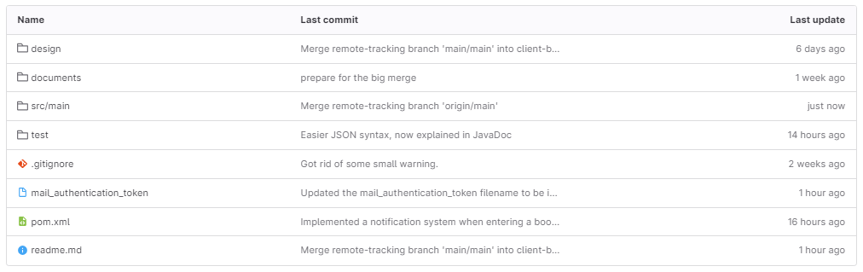
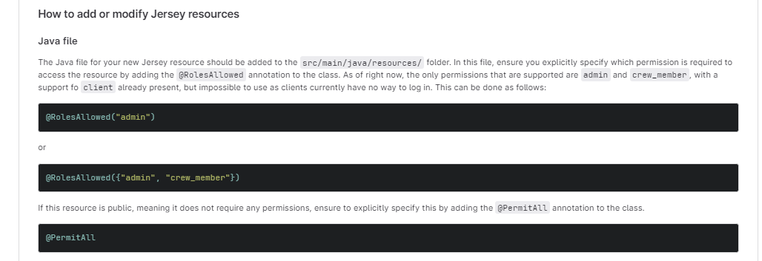
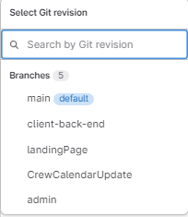
Gitlab
Feature Branching
Protected Main Branch

Slide 5
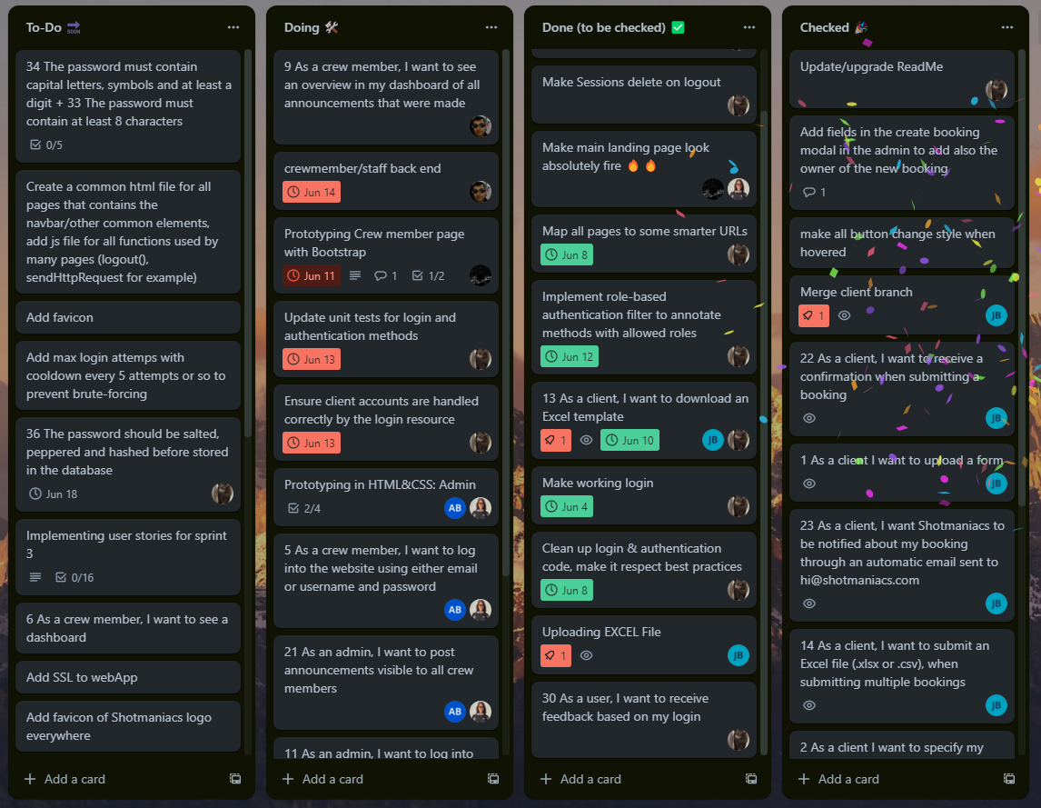
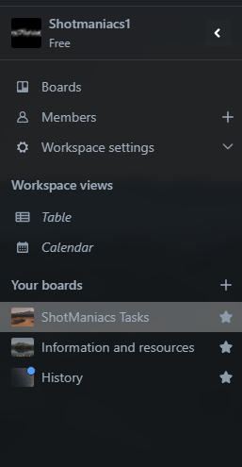
Trello

Slide 6
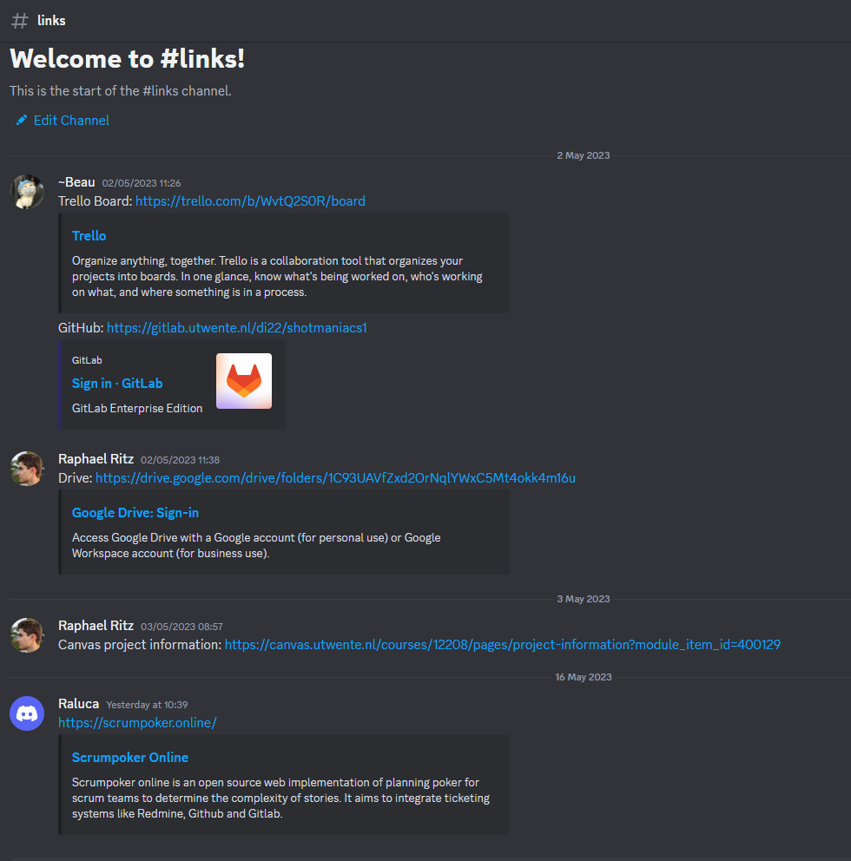
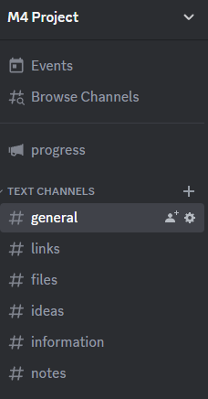
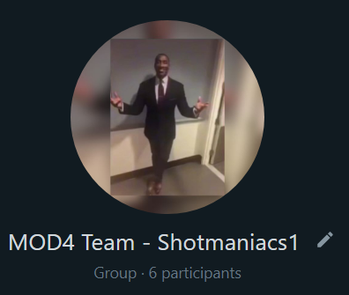
Communication

Slide 7
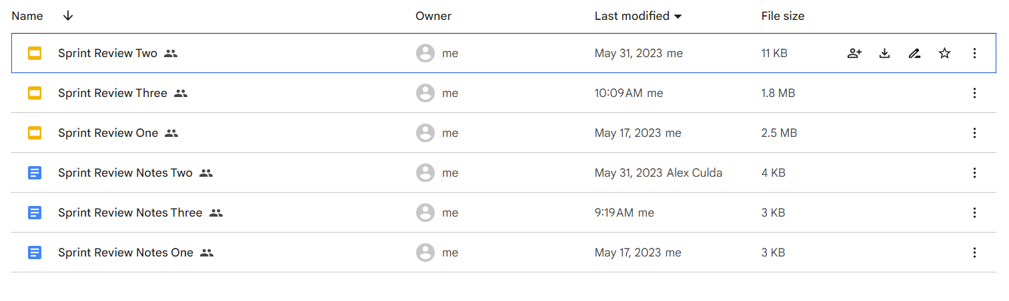
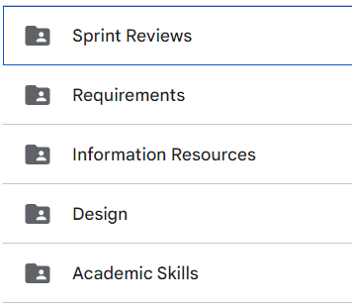
Drive

Slide 8
Planning.

Slide 9
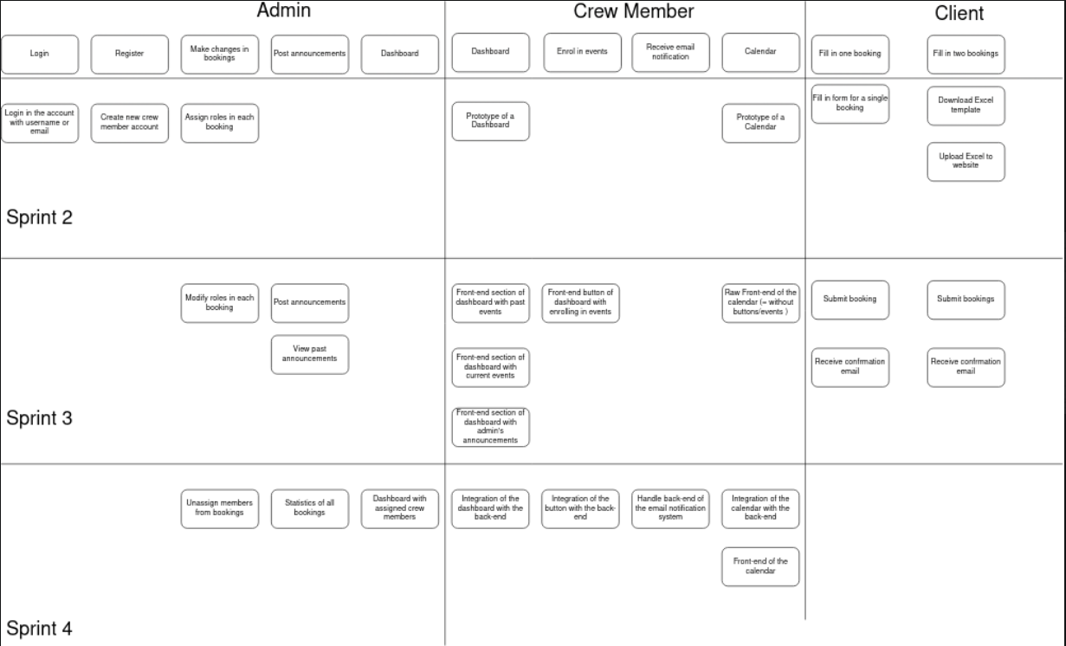
Story
Map

Slide 10
Story
Map

Slide 11
Design.

Slide 12
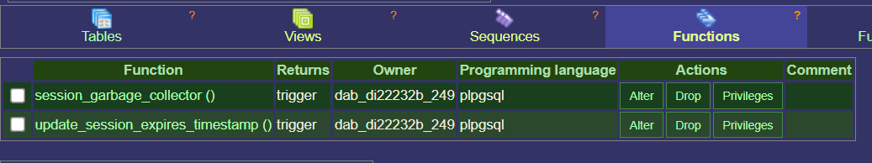
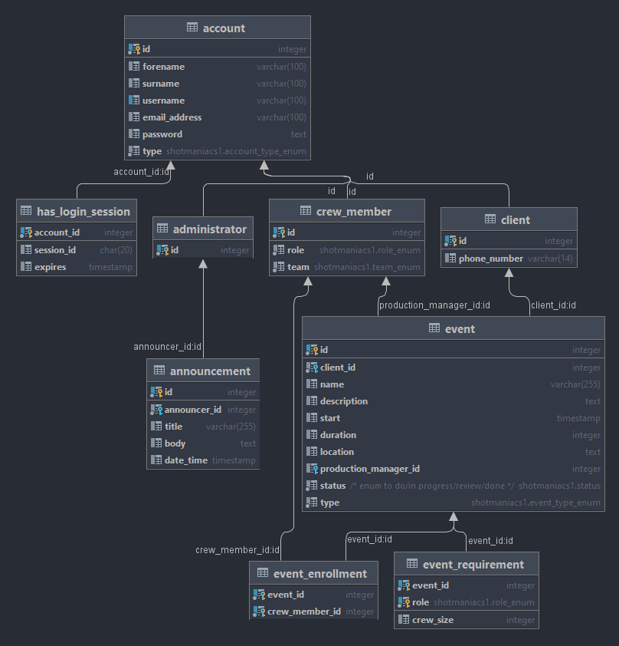
SQL-schema
Postgesql
Triggers
Session
Update timestamp

Slide 13
SQL-schema

Slide 14
Security.

Slide 15
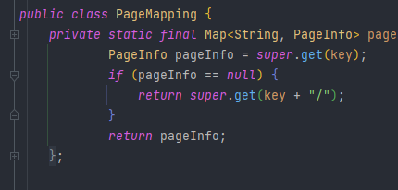
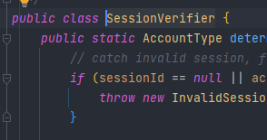
Security
Prepared Statements
Hashing and salting/peppering passwords
Safe password storage
Not yet implemented
Roles, through JAX-rs filters.
Authorisation
Filter
Page Mapping
L/R File Inclusion
Path Traversal

Slide 16
Testing.

Slide 17

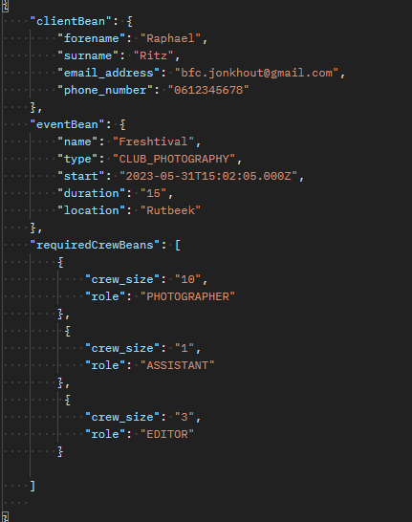

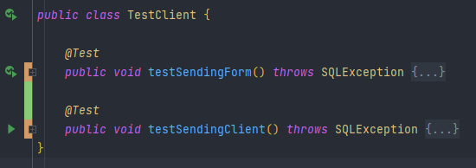
Testing
Postman
jUnit Testing
Application Testing
Test-driven development
Write request before back-end
SonarQube

Slide 18
Javax.mail;

Slide 19
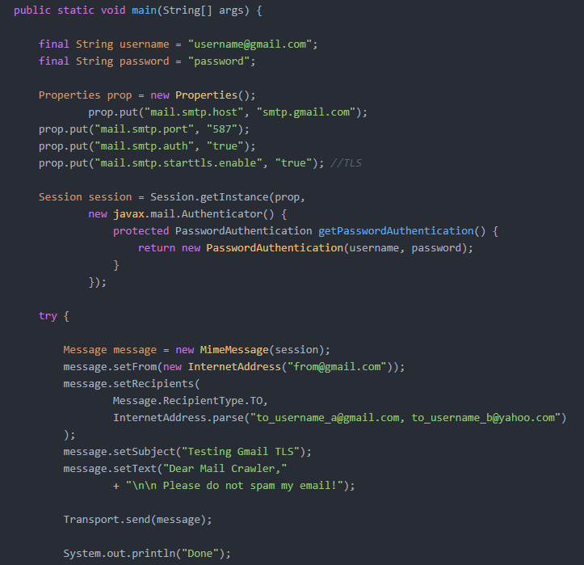

Java Mail
JavaMail sounds like the best way to do it.
Gives a broad interface for mail service.
Decided to connect it with personal gmail.

Slide 20
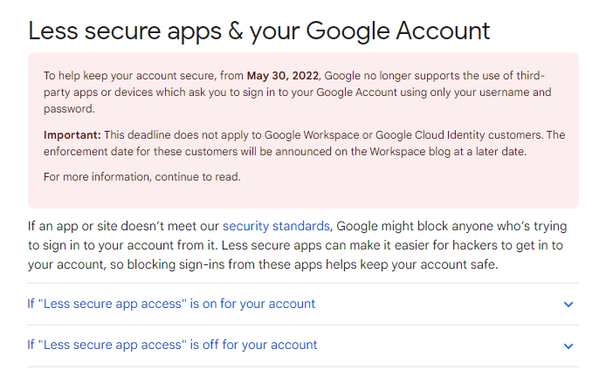
Java Mail
Then this happened

Slide 21



Java Mail
Solution?
Other SMTP
Keep using gmail…

Slide 22
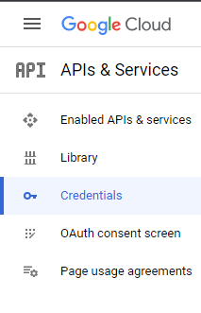
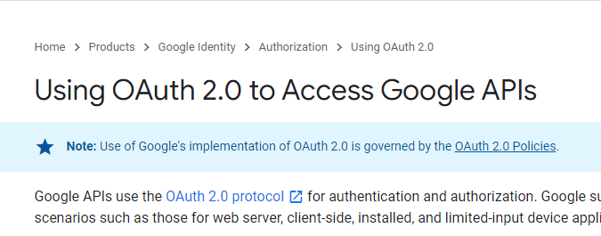
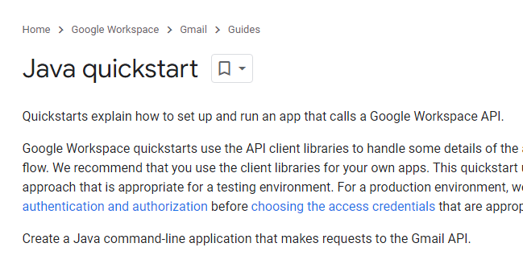
Java Mail
Using GMAIL Api
OAuth 2.0
Google Cloud
Java quickstart
API Credentials

Slide 23

Java Mail
Conclusion
Not recommended
Very secure
Problem
Takes user input, not supported by Tomcat.
Solution: Live File updating.

Slide 24
Demo.

Slide 25
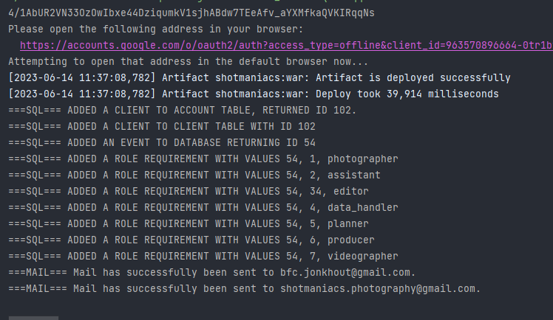
Features
Landing page
Full Client Functionality
Interlinked pages

Slide 26
Thank you for listening.
Beau Jonkhout, Pavan Awadhpersad, Baris Yilmaz, Raphael Ritz, Alex Culda, Raluca Gavrila

Slide 27
Questions..?

